Slide 1
Distributed Cloud Storage with Blockchain Technology
Vipin Kasarla
Head of Digital Transformation
Notes:
You have seen great presentations… now comes the most interesting of all!!! Innovation in storage industry, with a potential to disrupt the $100 B storage industry… and a must to support most of the use cases today.
How can you benefit from it? And how can you prepare and actions you take now.
Then… dig deep and look at how the blockchain enable new business models… I would take open and discuss the under the cover on how the technology make this possible.
How your business impacts…
And
Prove that I am worth listening… Grab attention .. Paint picture…
Tell why it is interesting, I – how it is being used? Why it is interesting for them?
D – Desire? Make it personable and desirable… Make them part of it… How would they benefit? What pains would it take away? What would it add?
A – Action… What are next steps… Walk me steps…
How do you Projection? – tech lead, passionate? Operations…
- I have been leading digital transf… exited about… potential…
Take-away?
-
What do I want to see happen? Action items.. Follow ups?
marketing tool…
Guest speaker…

Slide 2
Agenda
Philosophy of Blockchain
What is distributed storage ? How does it work?
How does Blockchain enables distributed storage?
What is the disruption potential of this technology?
What about the reliability, security and performance?
Current and future practical use cases?
Notes:
Society is society of intermediaries…
By its very nature, it provides the sort of web of
No more middlemen
the biggest change that blockchains are likely to bring is disintermediation
Security
Blockchain technology is sweeping the world with potential to spark a considerable change in the workflow of business procedures and pave the way for innovation and growth. In the business world, blockchain will radically change the enterprise by eliminating third-party facilitators, increasing data security and efficiency, and increasing the speed of transactions
Trust that the intermediaries and other commercial actors must build from the legal system, credit ratings agencies, the banking system, and so on.

Slide 3

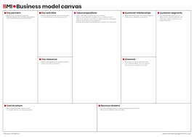


Agenda
Would the Blockchain disrupt or transform the way we store?
What type of new business models it would enable?
What is under the hood of this technology?
Practical tips and Roadmap
Notes:
Society is society of intermediaries…
By its very nature, it provides the sort of web of
No more middlemen
the biggest change that blockchains are likely to bring is disintermediation
Security
Blockchain technology is sweeping the world with potential to spark a considerable change in the workflow of business procedures and pave the way for innovation and growth. In the business world, blockchain will radically change the enterprise by eliminating third-party facilitators, increasing data security and efficiency, and increasing the speed of transactions
Trust that the intermediaries and other commercial actors must build from the legal system, credit ratings agencies, the banking system, and so on.

Slide 4
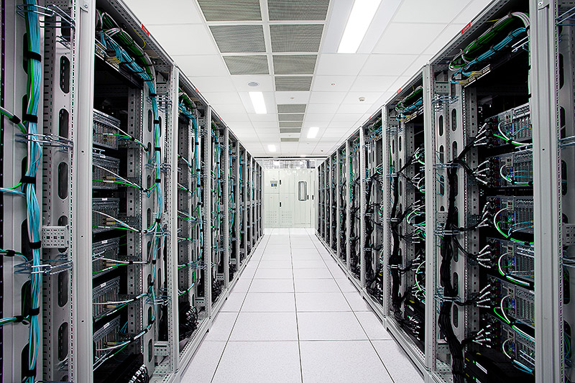

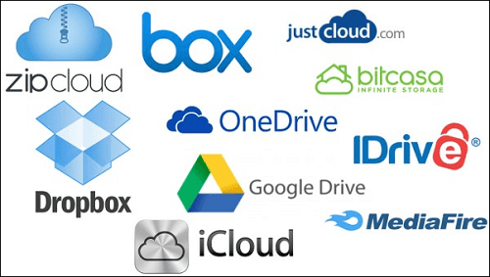
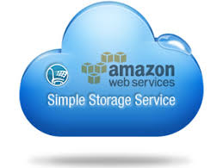
Storage
OnPrem data center
Cloud
Storage at your data center
Need more control
Feeling of more security
Privacy of data
Cloud Storage
Reliable uptime
Lower costs
Flexibility
$150 – $200 per TB/ Month
$23
per TB/Month
Can blockchain disrupt cloud storage industry?
Notes:
I see huge parallels between existing cloud storage infrastructure and existing financial infrastructure. Both rely on trusted third parties. Both could be more efficient and more affordable. Both will be replaced with blockchains.
Bitcoin brought a new type of distributed system into the world. A system where you did not need to trust. A crazy way of writing applications that can’t be shut down, even by their creators. Users of these applications can rely on them to be there tomorrow, because there’s no kill switch.
Only way to disrupt this centralized cloud storage is a new business model… NOT a new technology!!!
Cloud is disrupting datacenters, what could disrupt cloud?
That means, you need, cheaper, faster, more reliable than cloud???? Cloud that exist???
Lets explore!!!!
---
Blockchain is enabling new… business model…???

Slide 5
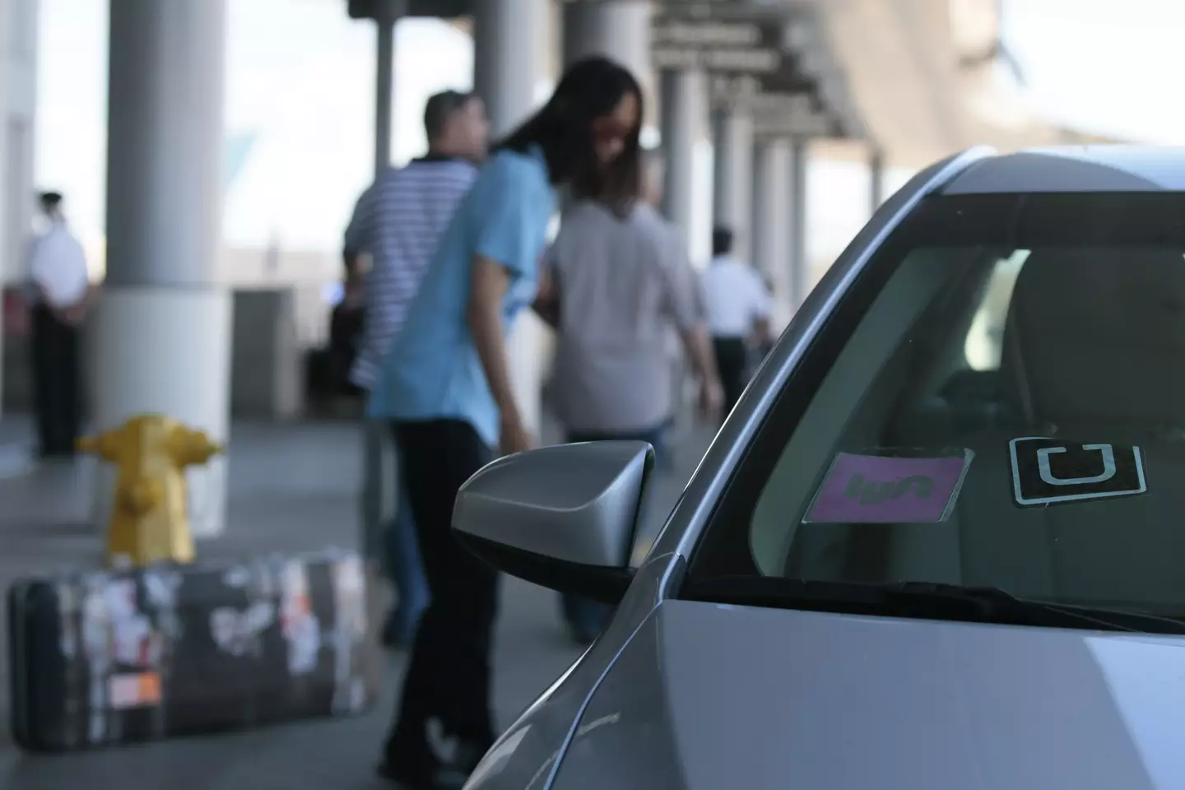

What would be the business model?
Uber disrupting Taxi industry!
Air BnB disrupting Hotel industry!!
Highly convenience while you Save money
Make money
Can anything disrupt cloud storage industry?
Notes:
Democratized the taxi service.
Decentralized by bringing down the barriers to entry.
Using extra capacity with your can and in your home.

Slide 6
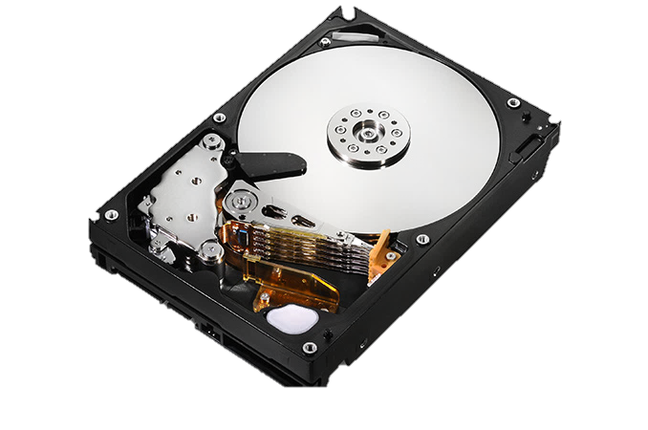
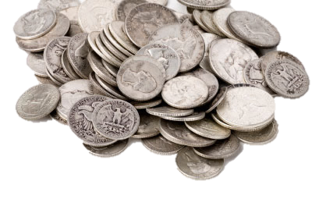
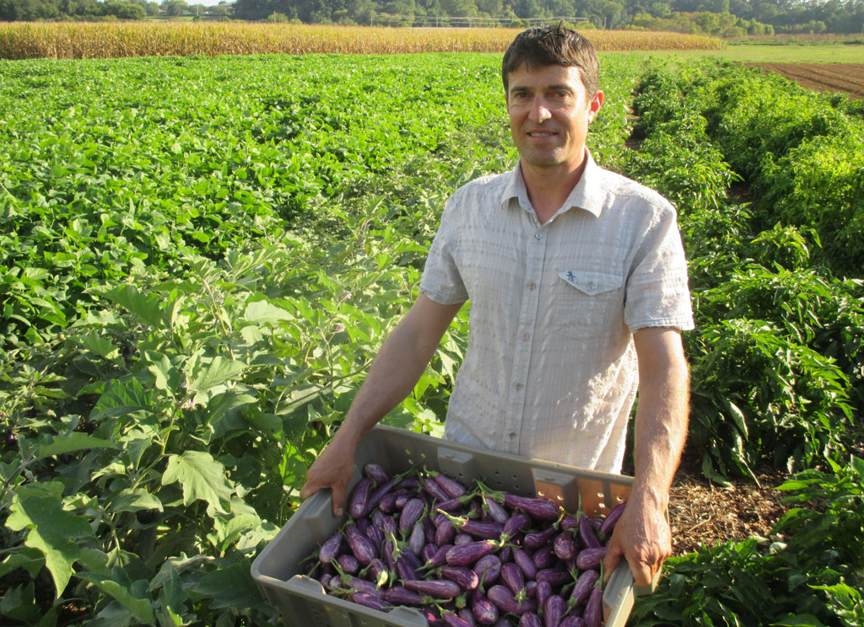
How storage industry is poised to change?
Why can’t you make money by renting excess Hard Disk?
When you rent your hard disk you become a farmer
How can you trust someone else's hard disk to store your private file?
How would you keep track of where the file is ?
How would you get it back?
Notes:
Are we saying that, we can simply take your file and save is someone else's hard disk? And pay them for saving it. How does that work?
Its not you just take the file and save it on someone else's hard disk…
My 13 year old…
Let me give you an idea of how the file leaves your desktop and saved on nodes of hard disk network?
How you get back…
How blockchain enables this?

Slide 7

How is the file Saved?
Data owner computer
Network
#1
Shard
HASH: A2021
File
100 MB
Encrypted
#2
HASH: B2021
Shard
NETWORK
#n
Shard
HASH: N2021
Notes:
This is where it excites us technologists? It s quite impressive and much needed innovation in storage space…

Slide 8
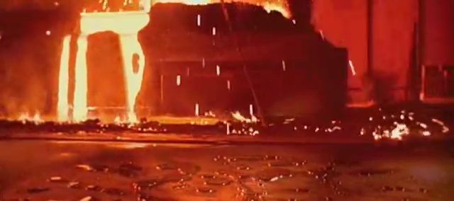
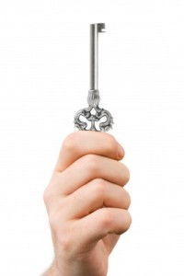
How is file retrieved?
Blockchain technology comes to rescue!
Notes:
Client-side Reed-Solomon erasure coding. Erasure coding algorithms break a file into k shards, and programmatically create m parity shards, giving a total of k + m = n shards. Any k of these n shards can be used to rebuild the file or any missing shards

Slide 9
How blockchain enables Distributed storage?
Smart Contracts
Cryptography
DLT
Micro-payments
Client
Have a file to store
Handshake &
Negotiation
Cryptography
Block relations
Payments
Retrieve and recreate file
Smart
Contracts
Sharding and distribution
Farmer -1
Allocate the storage
Sign the contract
Provide expected Service
Receive Payments
Record on
Distributed ledger
Farmer - n
Allocate the storage
Co-Sign the contract
Provide expected Service
Receive Payments
Notes:
Manage reliability, Verify the integrity and availability

Slide 10



Will it become mainstream ever?
Is it possible to become a biggest storage company by not owning a single data center?
Storj holding more than
150,000
storage nodes
60
Petabytes
205
Countries/ territories
Serial entrepreneur Ben Golub, co-founder and former CEO of Docker Inc., has landed at Storj Labs.
Notes:
If it is possible to become a biggest taxi company by not owning a single car?
“At Docker, we used to talk about building a programming layer for the Internet… to build applications and services that could run and interoperate seamlessly across the millions of devices connected by the Internet”
How much can they provide? Can you trust them?
For instance, a streaming video application may specify a need for high bandwidth, while archival storage needs only high availability. In a sufficiently large network, any need could be met.

Slide 11
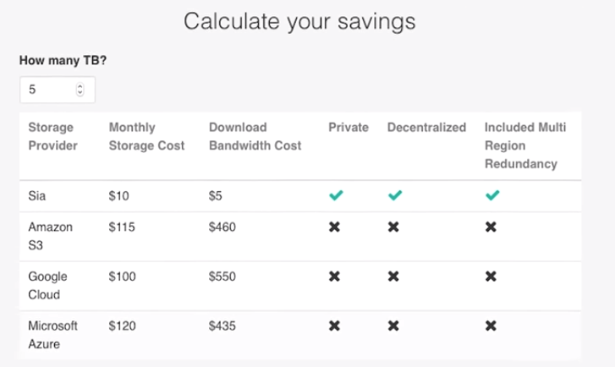
Cost savings?

Slide 12
Road ahead
The technology is being used by individuals, and is ready for production for organizations, focusing on cold storage.
By 2019, it will be ready for Warm storage and would be serving use cases like, for file sharing and the content distribution.
By 2020 it is quite likely to be ready to disrupt the major players in this $100 storage industry competing with Amazon S3 and Dropbox.
IoT would be the major users of this technology as machines start sharing data with no human intervention.
Notes:
2020… it pro prediction…
I predict…
Quite likely compete with…

Slide 13
Appendix

Slide 14
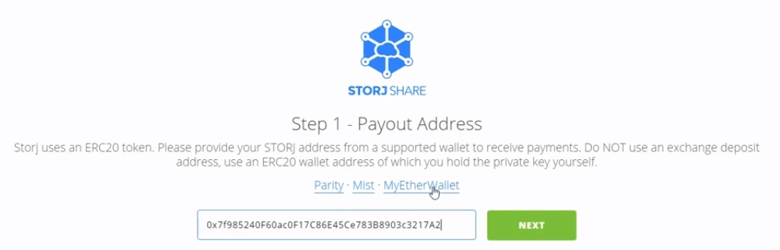
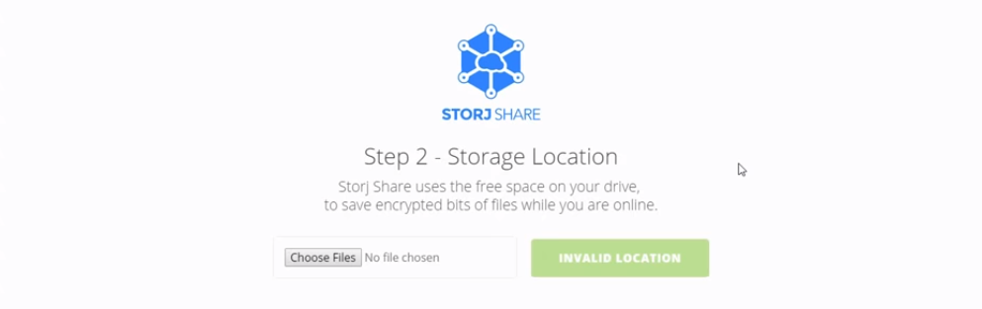
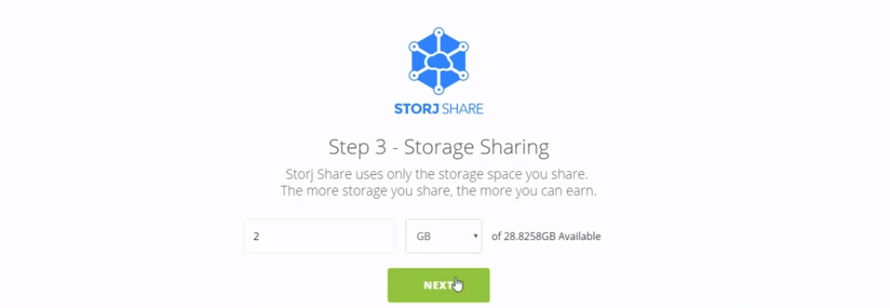

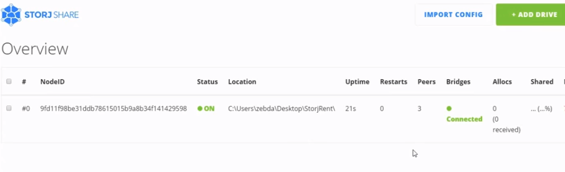
Farmer

Slide 15
www.oliverwyman.com/content/dam/oliver-wyman/global/en/2016/feb/BlockChain-In-Capital-Markets.pdf
https://www.forbes.com/sites/bernardmarr/2018/01/28/blockchain-and-the-internet-of-things-4-important-benefits-of-combining-these-two-mega-trends/
Apart from saving money what is the use case?

